Slide 1
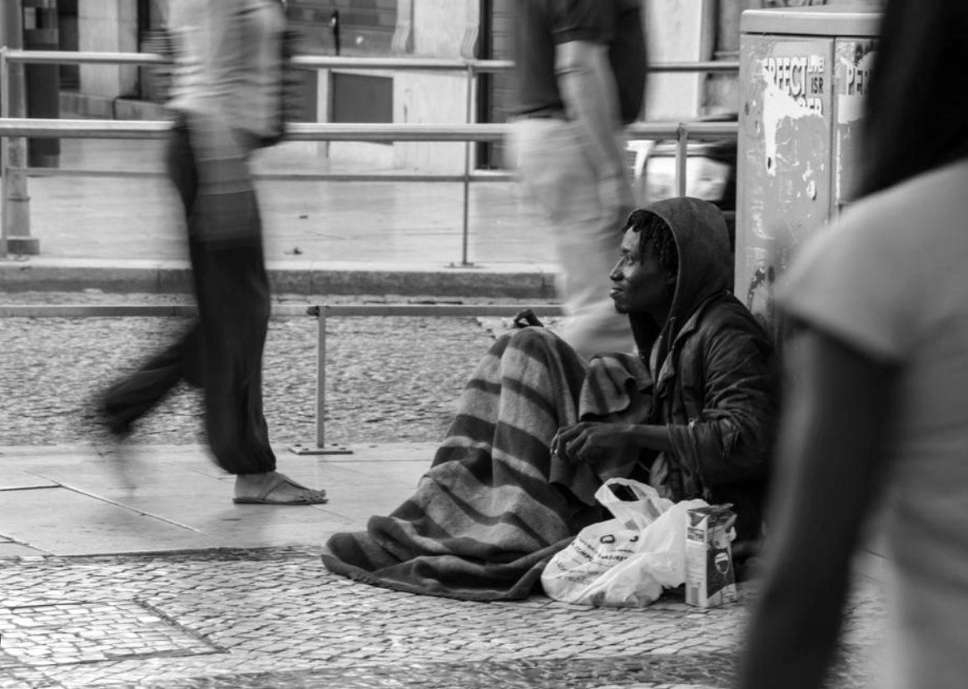

Data Science 1 Project on Homelessness
Presented by:
Udita Shukla
Alcina Travis
Ashee Gala
Anthony Uwaechia
Under the guidance of Dr. Genc Yegin

Slide 2
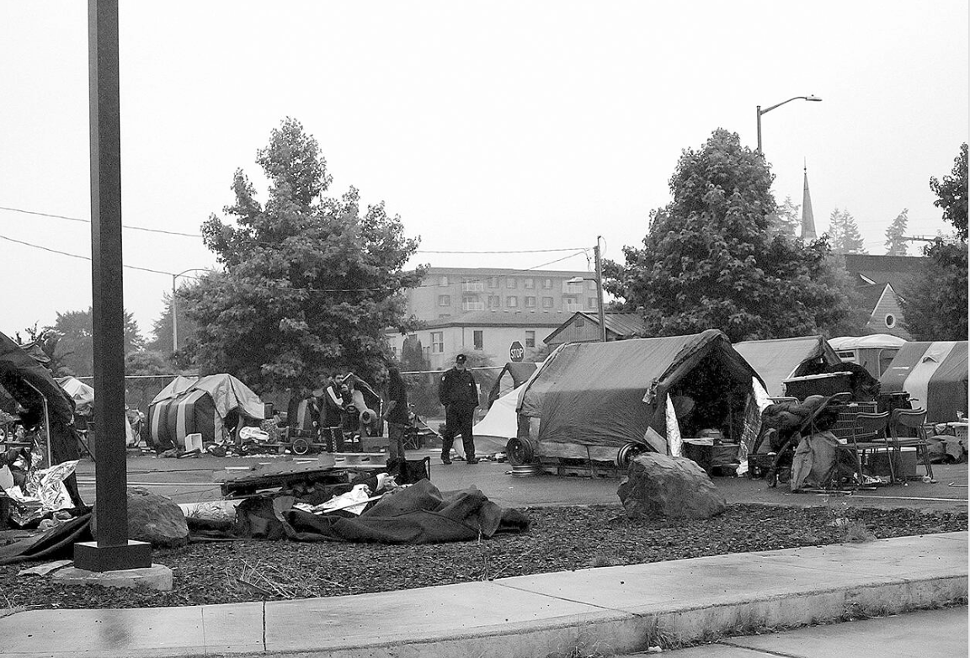
Introduction
The homelessness crisis in the US is on an increase year after year.
In this project we will be utilizing descriptive and predictive analysis to identify the driving factors behind the change in homelessness in US.
MAIN AGENDA
Understand the dataset
Descriptive analysis
Predictive analysis

Slide 3
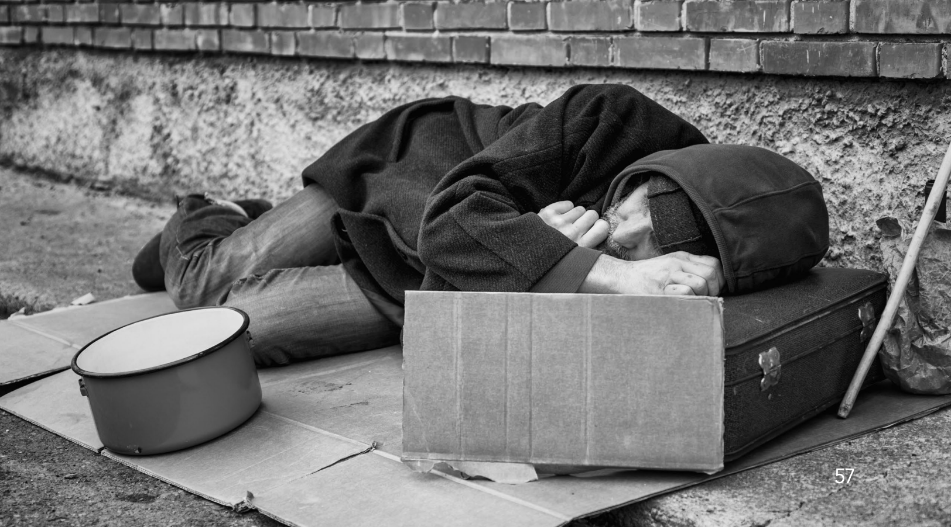
Introduction
America’s homelessness problem has the makings of an acute crisis
According to findings across several resources, on a single night in 2017, 553,742 people were experiencing homelessness in the United States. For every 10,000 people in the country, 17 were experiencing homelessness. Approximately two thirds (65%) were staying in emergency shelters or transitional housing programs, and about one third (35%) were in unsheltered locations. Homelessness increased for the first time in four years.
This finding also corelates with the findings in our dataset.
This project specifically aims to help researchers so that appropriate measures can be taken in order for the homelessness rates to decline.

Slide 4
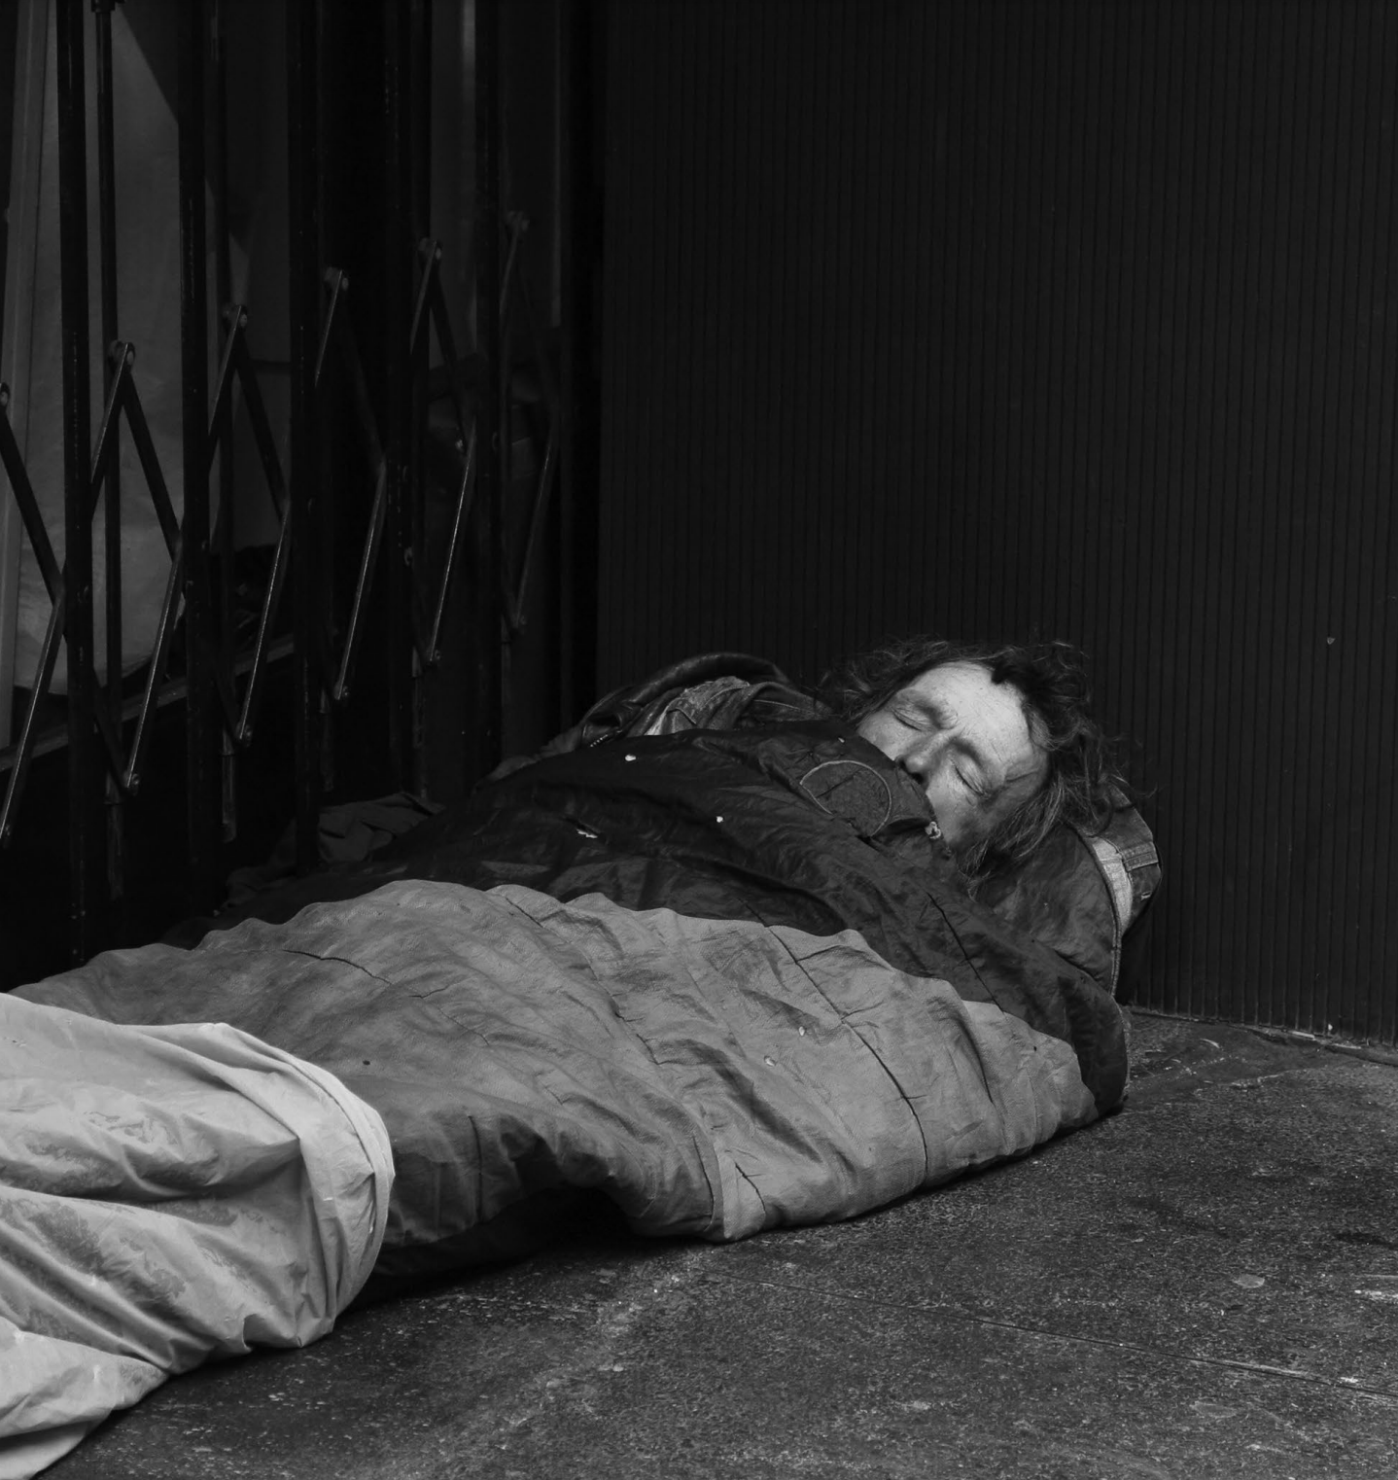
Understanding the dataset
The dataset was obtained from U.S. department of housing and urban development
The final dataset is a merger of 4 other dataset that contains, rent price, amount funded and unemployment.
The dataset has 18 variables and 204 observation
The dataset is a combined data of homelessness from 2014 to 2017 of each state in the US

Slide 5
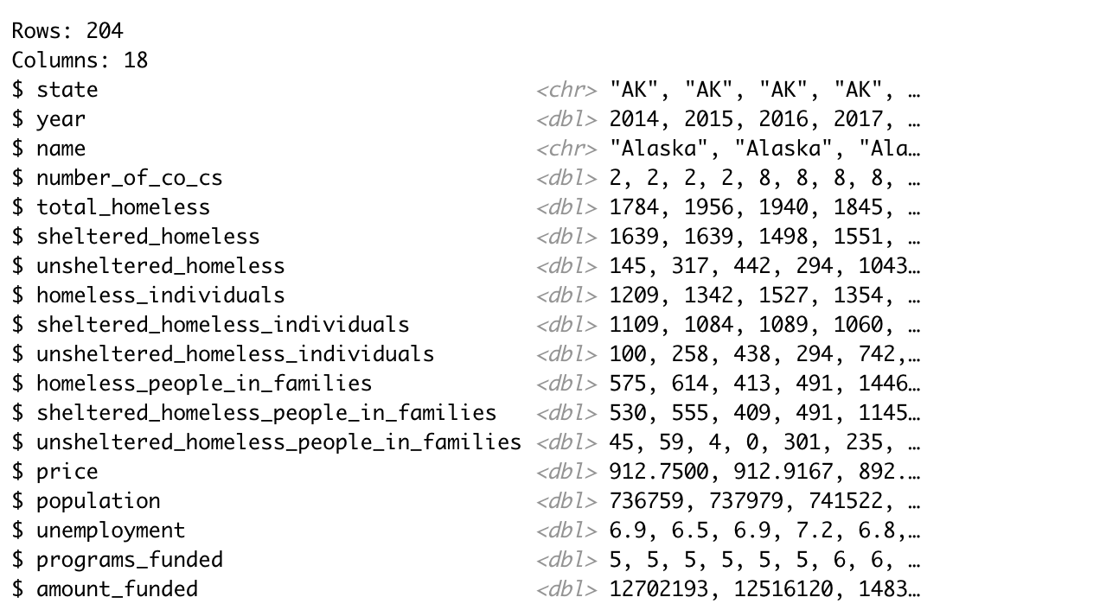
Dataset

Slide 6
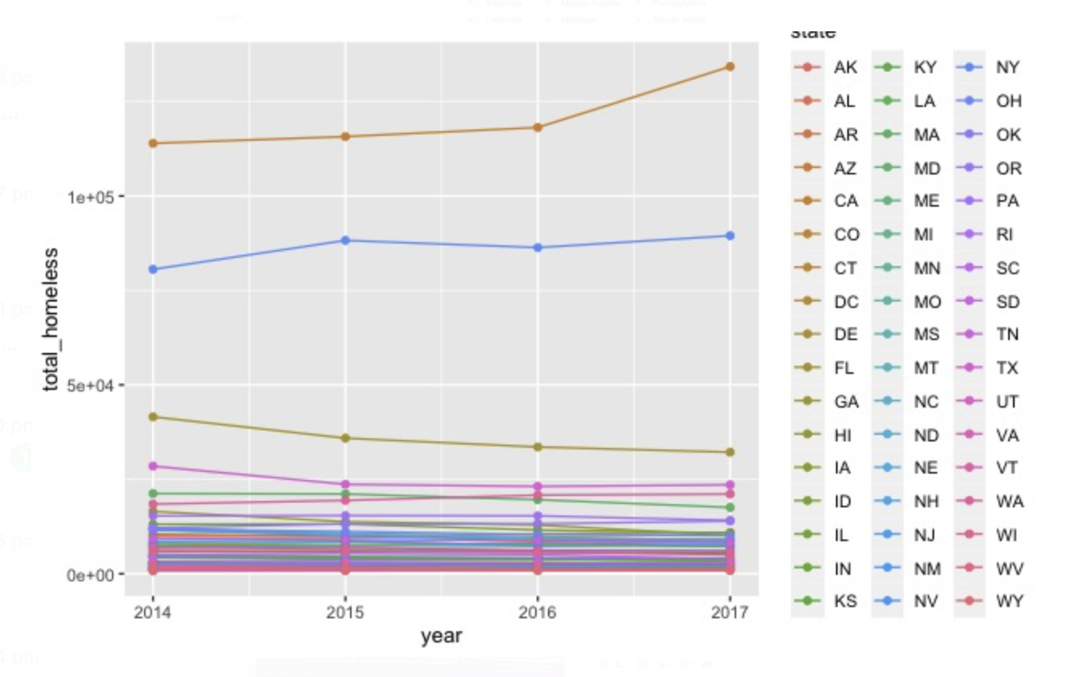
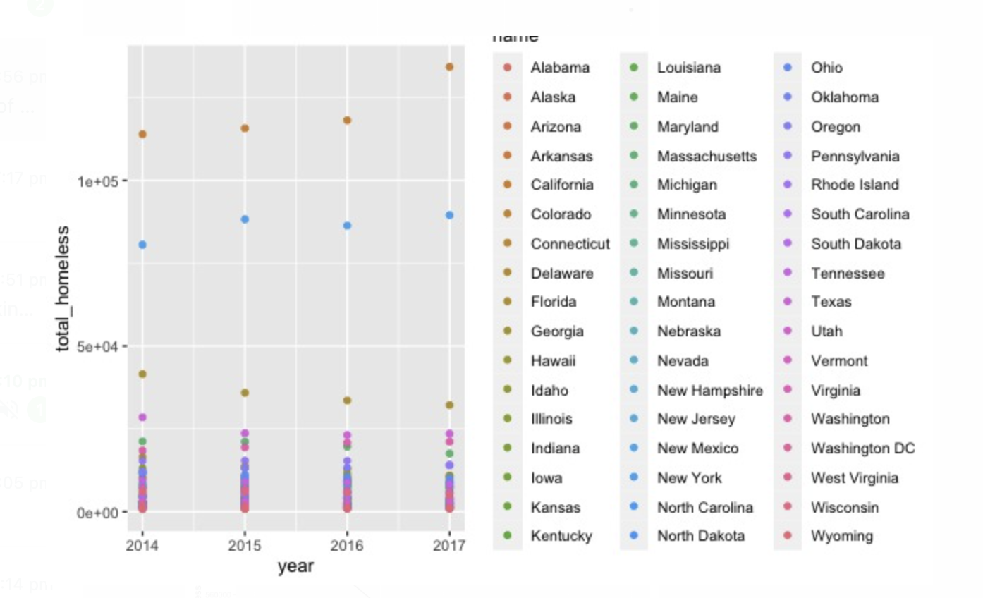
Descriptive analysis
Rise of total homelessness over the years

Slide 7
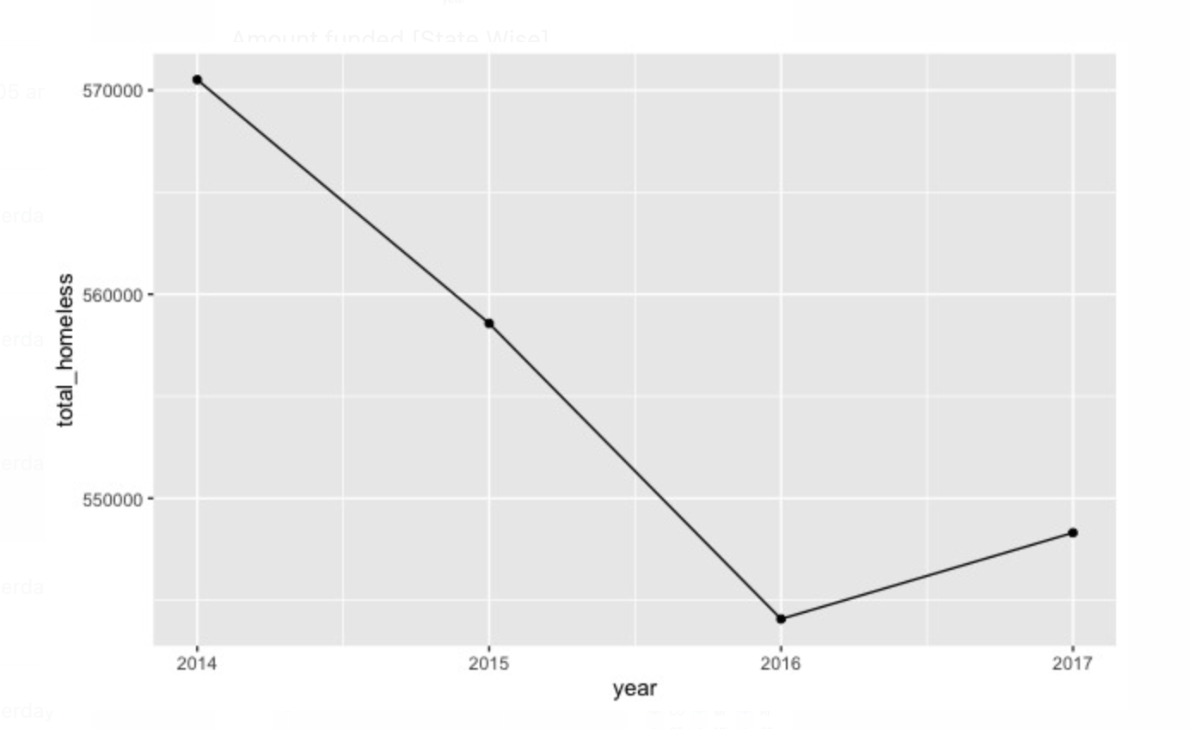
Rise of total homelessness over the years

Slide 8
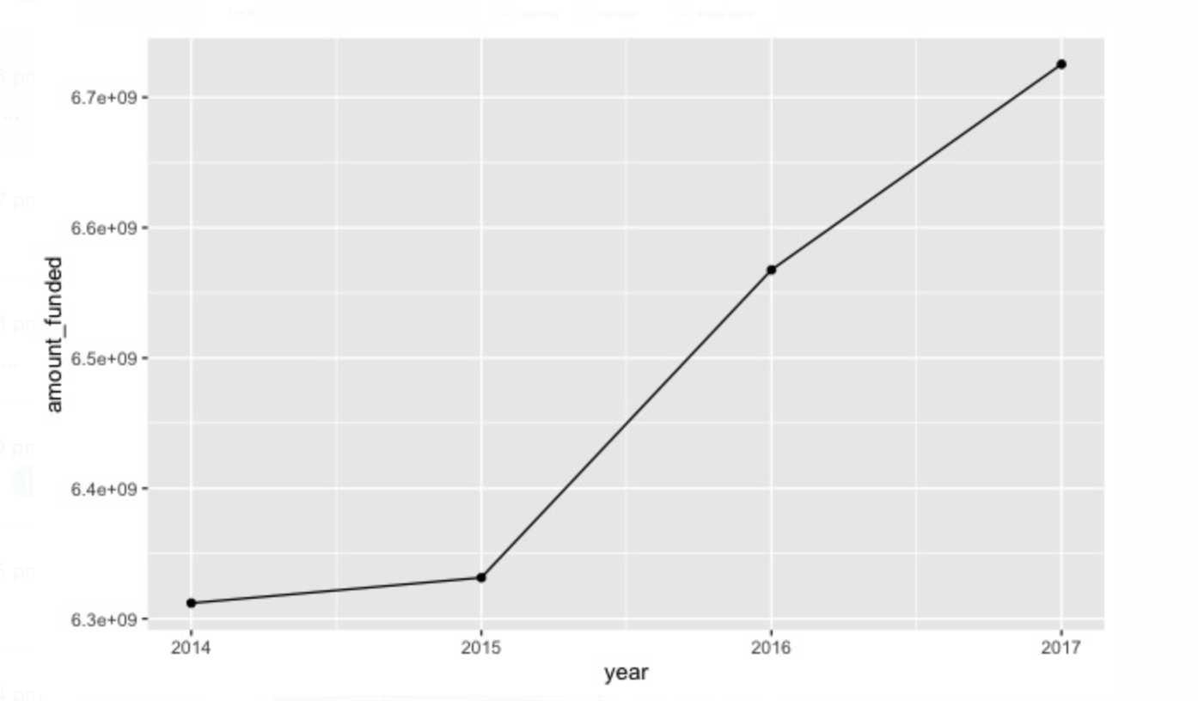
amount funded VS years

Slide 9
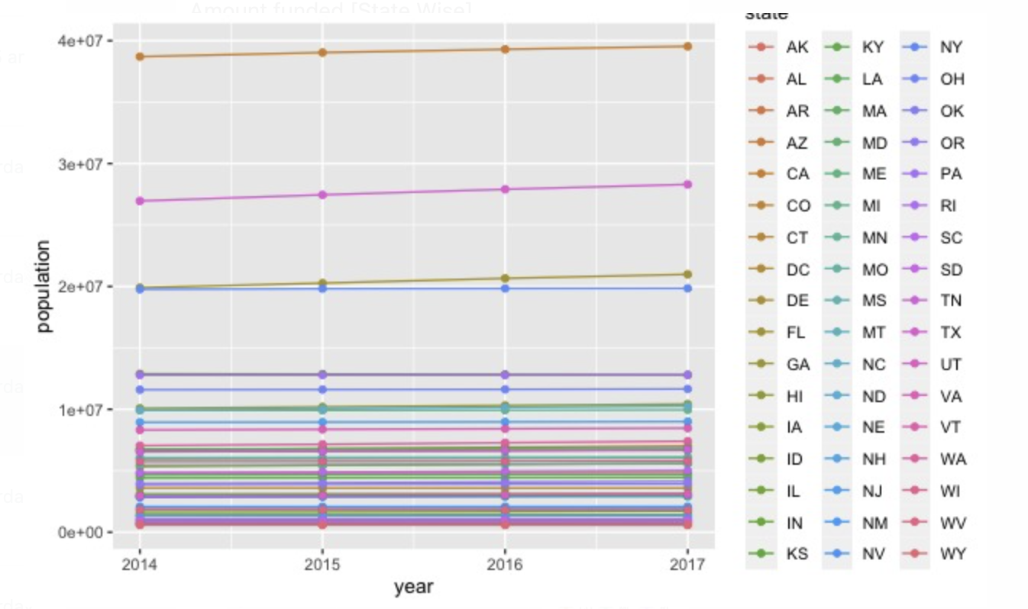
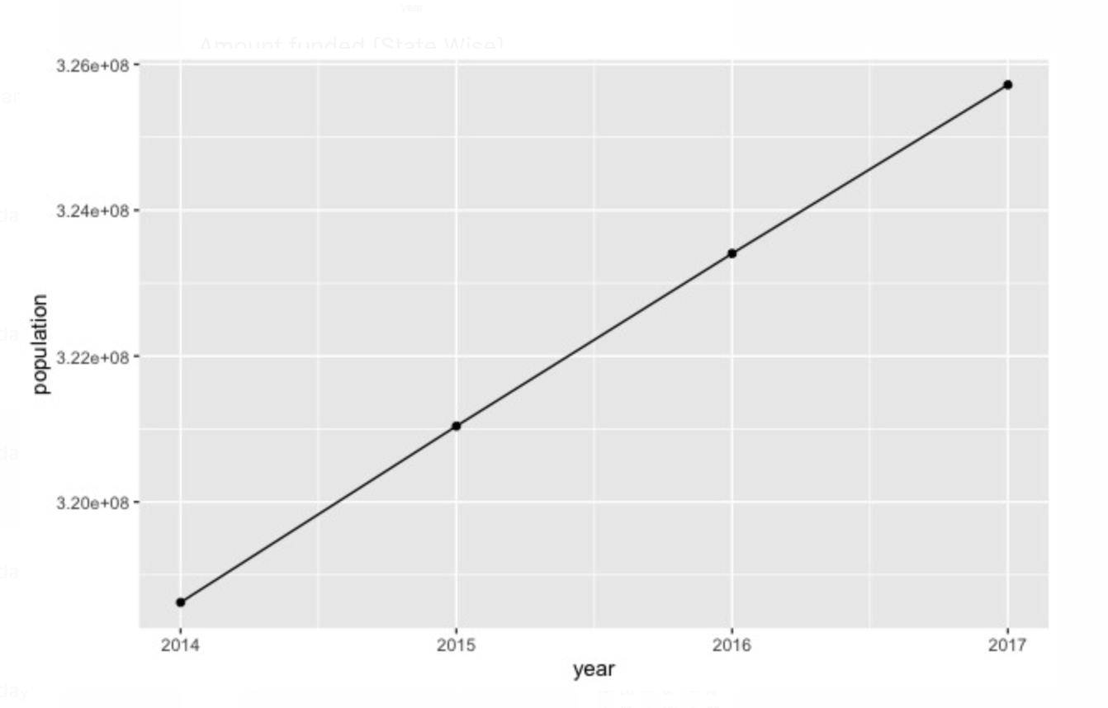
RISE OF POPULATION OVER THE YEARS

Slide 10
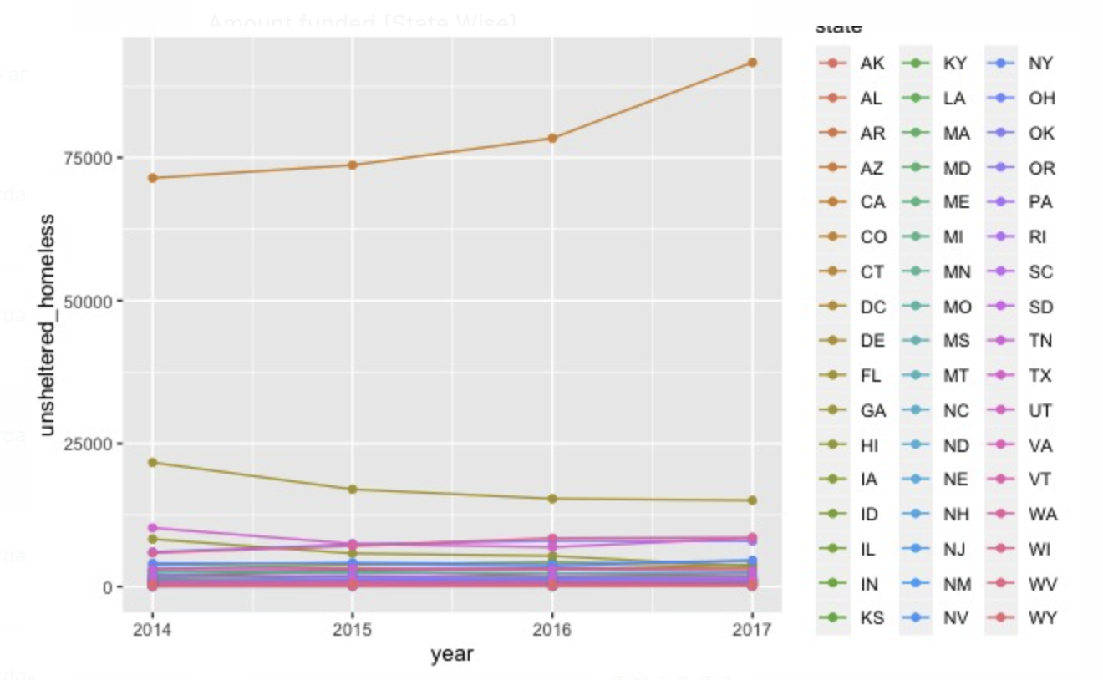
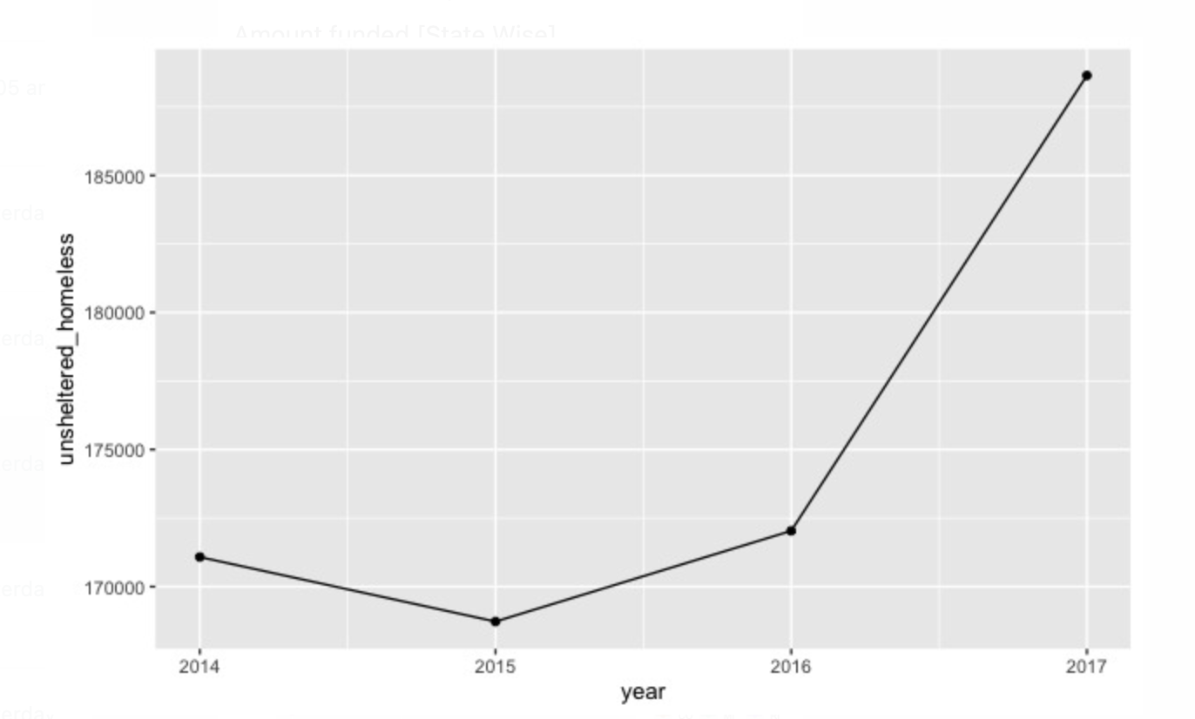
RISE IN UNSHELTERED HOMELESS OVER THE YEARS

Slide 11
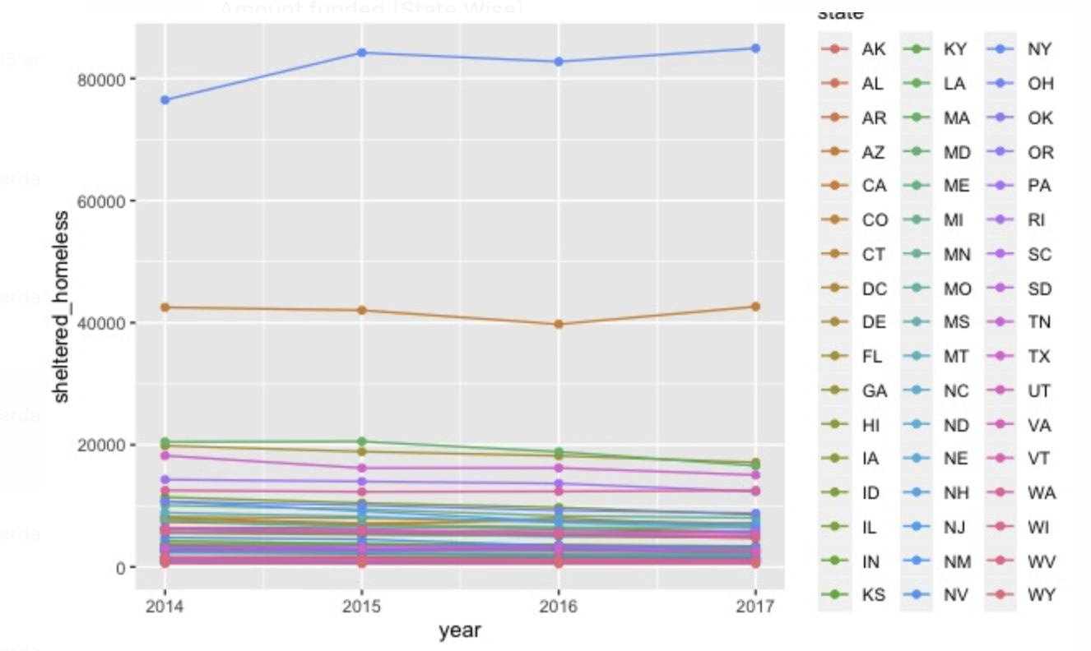
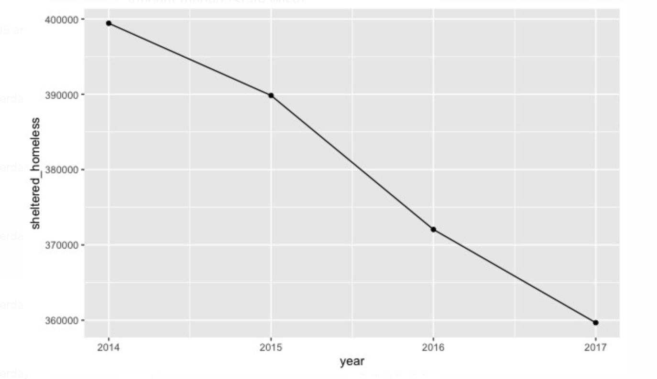
RISE OF SHELETERED HOMELESS PEOPLE OVER THE YEARS

Slide 12
Total homeless VS year

Slide 13
Predictive analysis

Slide 14
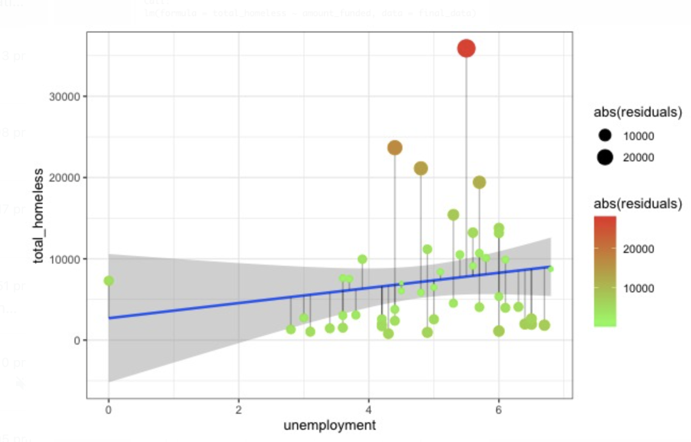
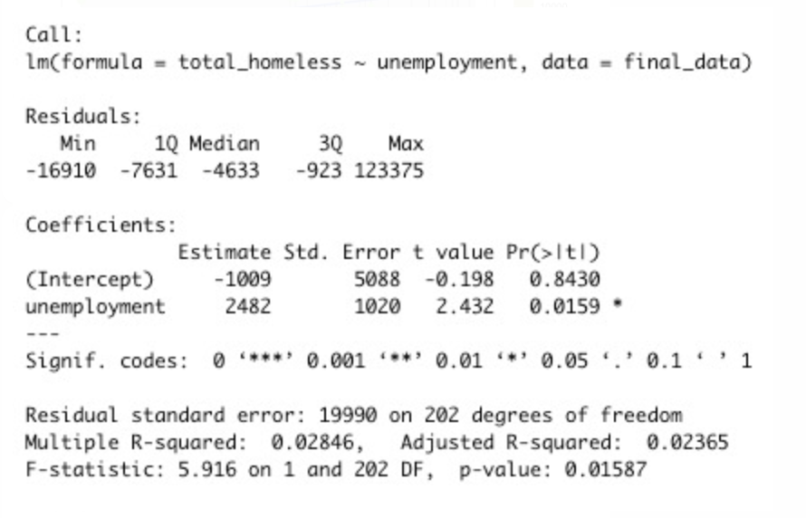
Relationship between total homeless and unemployment
Does unemployment affect the number of total homeless people?

Slide 15
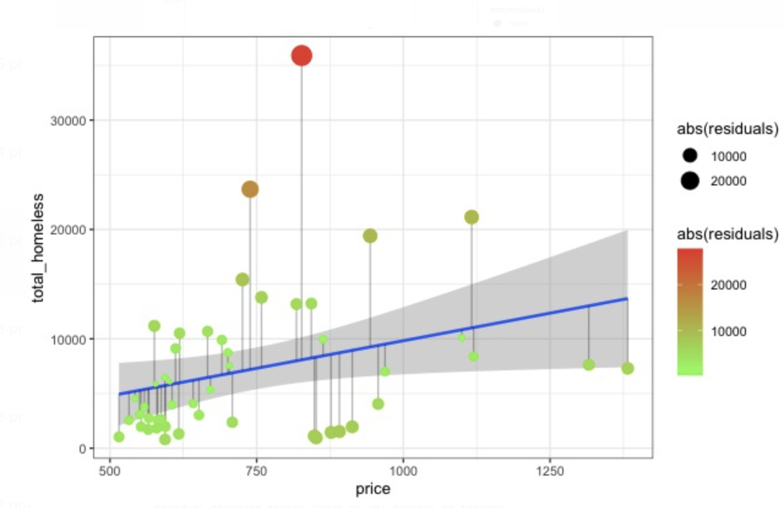
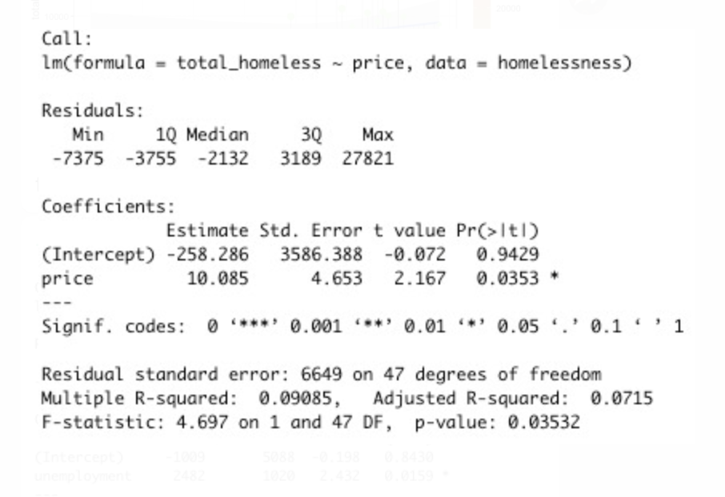
Predicting total homelessness on the basis of grants funded
Does rent price affect the total homeless people in US?

Slide 16
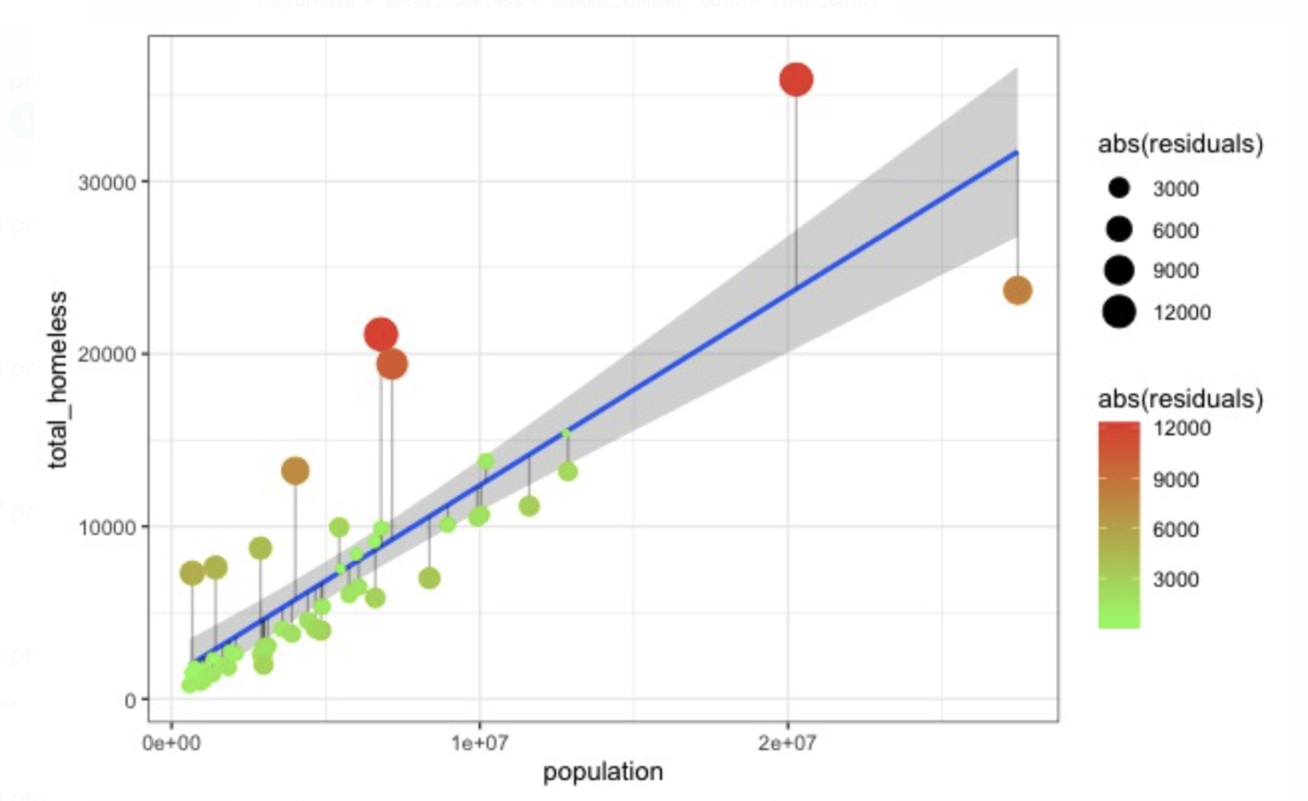
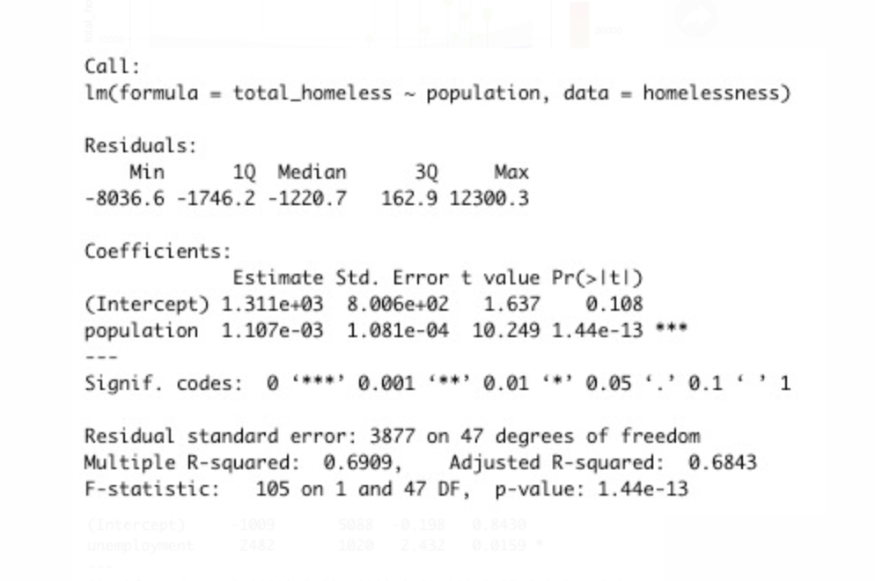
Relationship between total homeless and population
Does the population affect the total homeless people in US?

Slide 17
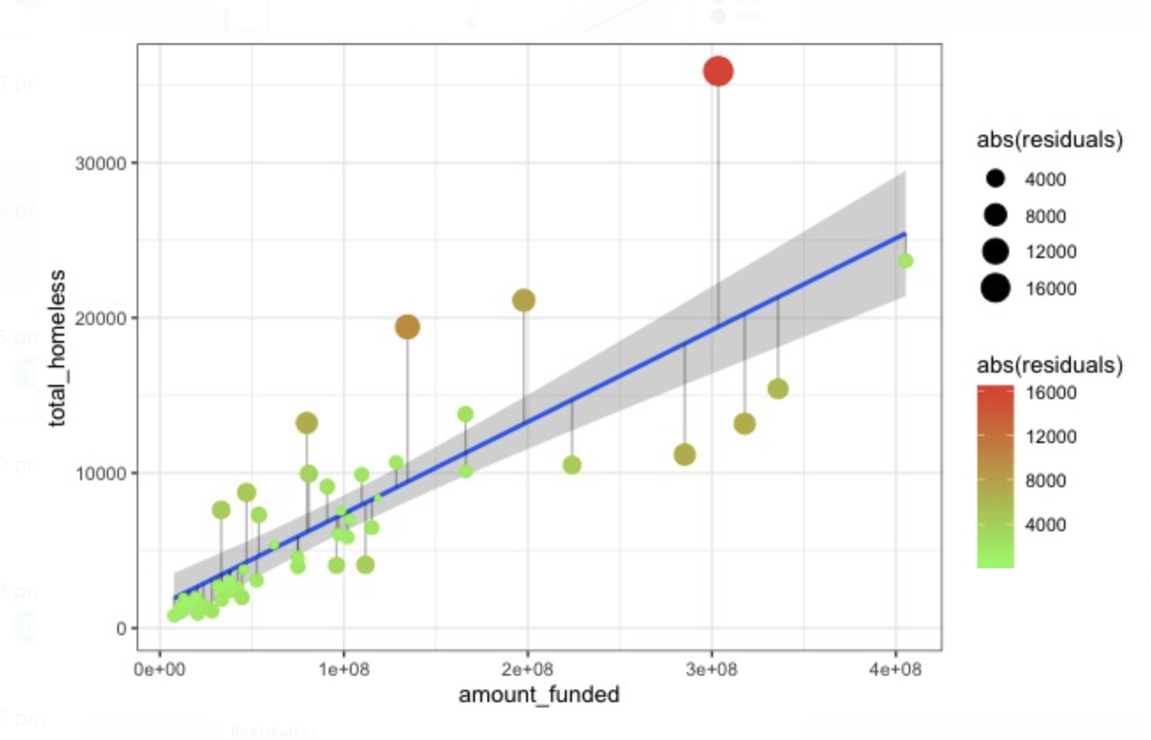
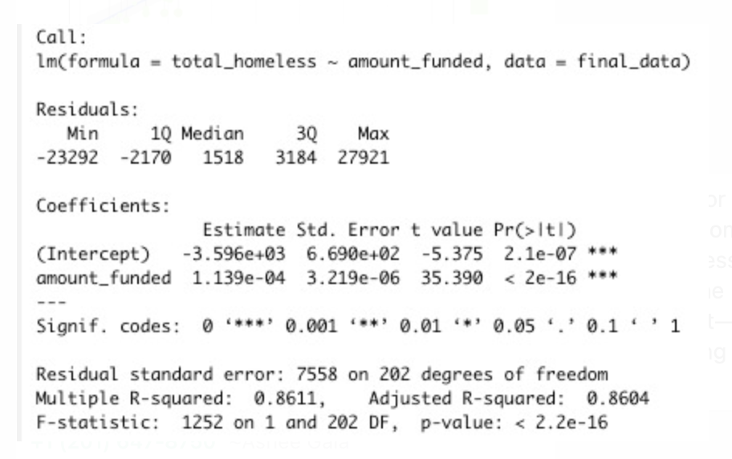
Relationship between total homeless and Amount funded

Slide 18
Thank you

